Slide 1

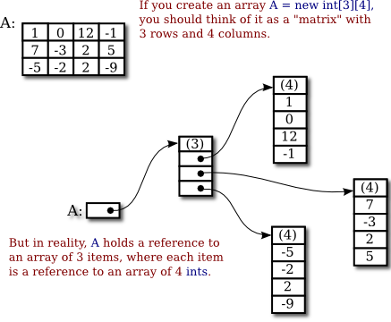
Introduction to Computer Science
Reichman University
Lecture 5-1
Two-Dimensional Arrays
Notes:
1

Slide 2
Two dimensional arrays
movie rating: (1 to 5)
movie id
 | 0 | 1 | 2 | 3 | 4
0 | 4 | 5 | 4 | 5 | 4
1 | 5 | 3 | 4 | 4 | 4
2 | 3 | 4 | 3 | 5 | 3
reviewer id

Slide 3
Two dimensional arrays
movie rating: (1 to 5)
sales data (units)
movie id
quarter
 | 0 | 1 | 2 | 3 | 4
0 | 4 | 5 | 4 | 5 | 4
1 | 5 | 3 | 4 | 4 | 4
2 | 3 | 4 | 3 | 5 | 3
 | 1 | 2 | 3 | 4
1 | 10 | 12 | 20 | 12
2 | 12 | 14 | 25 | 18
3 | 14 | 16 | 22 | 17
4 | 9 | 12 | 35 | 20
5 | 11 | 15 | 30 | 22
reviewer id
model
image (black / white pixels)
image (greyscale pixels)
column
column
 | 0 | 1 | 2 | 3 | 4 | 5 | 6 | 7
0 | 0 | 0 | 0 | 0 | 0 | 0 | 0 | 0 | 0
1 | 0 | 0 | 1 | 1 | 1 | 1 | 0 | 0 | 0
2 | 0 | 0 | 0 | 1 | 1 | 1 | 1 | 0 | 0
3 | 0 | 0 | 0 | 0 | 1 | 1 | 1 | 1 | 0
4 | 0 | 0 | 0 | 0 | 0 | 0 | 0 | 0 | 0
 | 0 | 0 | 0 | 0 | 0 | 0 | 0 | 0 | 0
 | 0 | 1 | 2 | 3 | 4 | 5 | 6 | 7
0 | 0 | 0 | 0 | 0 | 0 | 0 | 0 | 0 | 0
1 | 0 | 0 | 0 | 0 | 0 | 0 | 0 | 0 | 0
2 | 0 | 255 | 255 | 255 | 255 | 255 | 0 | 0 | 0
3 | 0 | 112 | 17 | 17 | 83 | 83 | 0 | 0 | 0
4 | 0 | 76 | 76 | 63 | 63 | 63 | 0 | 0 | 0
 | 0 | 0 | 0 | 0 | 0 | 0 | 0 | 0 | 0
...
...
row
row
...
...

Slide 4
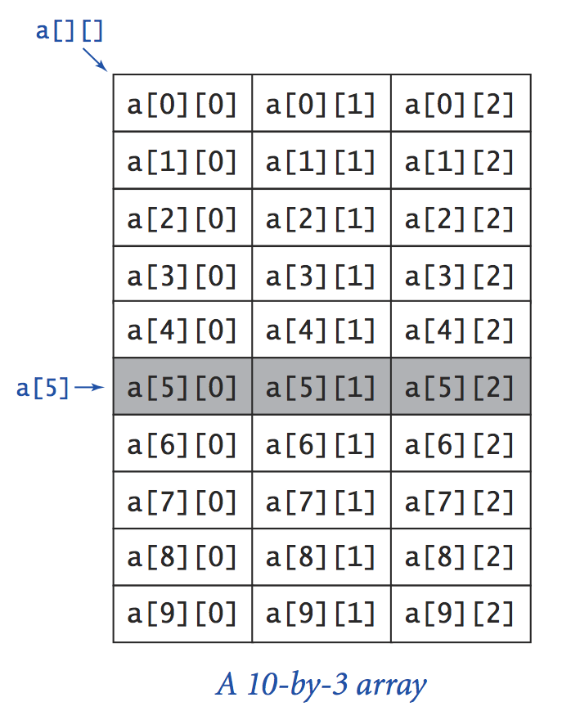
Two dimensional arrays
Technically speaking
A 2D array is an array of 1D arrays
“Row” a[i] is a 1D array whose elements are:
a[i][0], a[i][1], a[i][2]
Conventions
Row and column indexes start at 0
The (row,col) element is accessed by a[row][col]
Number of rows: a.length
Number of elements in row i: a[i].length

Slide 5
Example
// Computes the sums of the rows in a table.
// Stores the sums in the rightmost column.
public class SumOfRow {
% java SumOfRow
6 10 6 22
7 11 17 35
3 15 1 19
14 6 13 33
13 6 0 19
sum of each row

Slide 6
Example
// Computes the sums of the rows in a table.
// Stores the sums in the rightmost column.
public class SumOfRow {
public static void main(String[] args) {
// Defines a 5 by 4 2D array, and puts random values in the
// range 0...19 in the leftmost 3 columns, for testing
int[][] arr = new int[5][4];
for (int i = 0; i < 5; i++) {
for (int j = 0; j < 3; j++) {
arr[i][j] = (int) (20 * Math.random());
}
}
// Stores the sum of each row at the rightmost column
for (int i = 0; i < 5; i++) {
int sum = 0;
for (int j = 0; j < 3; j++) {
sum = sum + arr[i][j];
}
arr[i][3] = sum;
}
% java SumOfRow
6 10 6 22
7 11 17 35
3 15 1 19
14 6 13 33
13 6 0 19
sum of each row

Slide 7
Example
// Computes the sums of the rows in a table.
// Stores the sums in the rightmost column.
public class SumOfRow {
public static void main(String[] args) {
// Defines a 5 by 4 2D array, and puts random values in the
// range 0...19 in the leftmost 3 columns, for testing
int[][] arr = new int[5][4];
for (int i = 0; i < 5; i++) {
for (int j = 0; j < 3; j++) {
arr[i][j] = (int) (20 * Math.random());
}
}
// Stores the sum of each row at the rightmost column
for (int i = 0; i < 5; i++) {
int sum = 0;
for (int j = 0; j < 3; j++) {
sum = sum + arr[i][j];
}
arr[i][3] = sum;
}
// Prints the array
for (int i = 0; i < 5; i++) {
for (int j = 0; j < 4; j++) {
System.out.printf("%4s", arr[i][j]);
}
System.out.println();
}
}
}
% java SumOfRow
6 10 6 22
7 11 17 35
3 15 1 19
14 6 13 33
13 6 0 19
sum of each row
Prints the value using 4 positions, right justified.

Slide 8

Plan
2D arrays: Basic concepts
Example: Matrix operations
Internal view of 2D arrays
Aside topic: Reading data from a file
PageRank algorithm (example of 2D array processing)

Slide 9
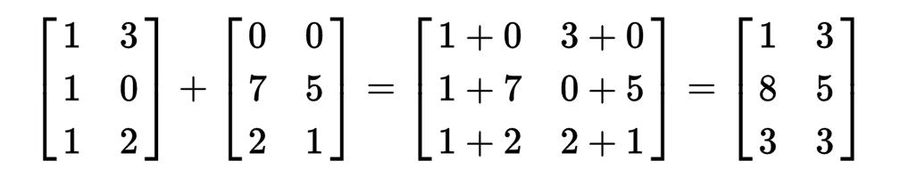
Matrix operations
Addition
Precondition: The two matrices must have the same dimensions.
// Computes the matrix addition sum = m1 + m2
// Assumes that m1, m2 have the same dimensions
int N = m1.length; // number of rows
int M = m1[0].length; // number of columns
int[][] sum = new int[N][M];
for (int i = 0; i < N; i++) {
for (int j = 0; j < M; j++) {
sum[i][j] = m1[i][j] + m2[i][j];
}
}

Slide 10
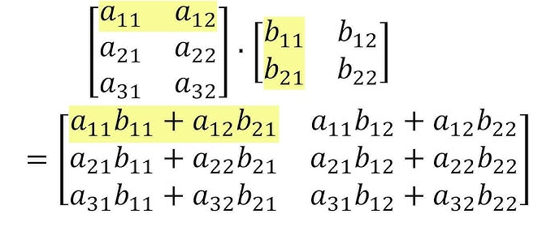
Matrix operations
Multiplication
Precondition: The number of columns in the left matrix must equal the number of rows in the right matrix.

Slide 11
Matrix operations
/** Features matrix operations */
public class MatrixOps {
/** Returns the matrix addition m1 + m2. Assumes that they have the same dimensions. */
public static int[][] add(int[][] m1, int[][] m2)
/** Returns the matrix multiplication m1 * m2. Assumes that they have the same dimensions. */
public static int[][] mult(int[][] m1, int[][] m2)
/** Prints the given matrix. */
public static void println(int[][] m)
}
/** Features matrix operations. */
public class MatrixOps {
// Illustrates using the class functions
public static void main(String args[]) {
int[][] a = { { 7, 2, 1 },
{ 3, 6, 1 },
{ 5, 1, 4 } };
int[][] b = { { 8, 3, 5 },
{ 1, 4, 1 },
{ 1, 3, 4 } };
println(a);
println(b);
println(add(a, b));
println(mult(a, b));
...
MatrixOps API
% java MatrixOps
7 2 1
3 6 1
5 1 4
8 3 5
1 4 1
1 3 4
15 5 6
4 10 2
6 4 8
59 32 41
31 36 25
45 31 42
a
b
a + b
a ⨉ b

Slide 12
Matrix operations
/** Features matrix operations */
public class MatrixOps {
/** Returns the matrix addition m1 + m2. Assumes that they have the same dimensions. */
public static int[][] add(int[][] m1, int[][] m2)
/** Returns the matrix multiplication m1 * m2. Assumes that they have the same dimensions. */
public static int[][] mult(int[][] m1, int[][] m2)
/** Prints the given matrix. */
public static void println(int[][] m)
}
/** Features matrix operations. */
public class MatrixOps {
// Illustrates using the class functions
public static void main(String args[]) {
int[][] a = { { 7, 2, 1 },
{ 3, 6, 1 },
{ 5, 1, 4 } };
int[][] b = { { 8, 3, 5 },
{ 1, 4, 1 },
{ 1, 3, 4 } };
println(a);
println(b);
println(add(a, b));
println(mult(a, b));
...
// Creates and computes c = a ⨉ (a + b)
int[][] c = mult(a, add(a, b));
// Computes c = (a + c) ⨉ b + c
c = add((mult(add(a, c), b), c);
...
}
/** Returns the addition of the two given matrices */
public static int[][] add(...) {...}
/** Returns the product of the two given matrices */
public static int[][] mult(...) {...}
/** Prints the given matrix. */
private static void println(int[][] m) {...}
}
MatrixOps API
% java MatrixOps
7 2 1
3 6 1
5 1 4
8 3 5
1 4 1
1 3 4
15 5 6
4 10 2
6 4 8
59 32 41
31 36 25
45 31 42
a
b
a + b
a ⨉ b

Slide 13
Matrix operations
/** Features matrix operations */
public class MatrixOps {
/** Returns the matrix addition m1 + m2. Assumes that they have the same dimensions. */
public static int[][] add(int[][] m1, int[][] m2)
/** Returns the matrix multiplication m1 * m2. Assumes that they have the same dimensions. */
public static int[][] mult(int[][] m1, int[][] m2)
/** Prints the given matrix. */
public static void println(int[][] m)
}
/** Features matrix operations. */
public class MatrixOps {
// Illustrates using the class functions
public static void main(String args[]) {
int[][] a = { { 7, 2, 1 },
{ 3, 6, 1 },
{ 5, 1, 4 } };
int[][] b = { { 8, 3, 5 },
{ 1, 4, 1 },
{ 1, 3, 4 } };
println(a);
println(b);
println(add(a, b));
println(mult(a, b));
...
// Creates and computes c = a ⨉ (a + b)
int[][] c = mult(a, add(a, b));
// Computes c = (a + c) ⨉ b + c
c = add((mult(add(a, c), b), c);
...
}
/** Returns the addition of the two given matrices */
public static int[][] add(...) {...}
/** Returns the product of the two given matrices */
public static int[][] mult(...) {...}
/** Prints the given matrix. */
private static void println(int[][] m) {...}
}
MatrixOps API
% java MatrixOps
7 2 1
3 6 1
5 1 4
8 3 5
1 4 1
1 3 4
15 5 6
4 10 2
6 4 8
59 32 41
31 36 25
45 31 42
Notice how add, mult, println are used as black box abstractions;
We will now open up the black boxes.
a
b
a + b
a ⨉ b

Slide 14
Matrix operations
Implementation
/** Features matrix operations. */
public class MatrixOps {
public static void main(String args[]) {
// Performs various tests (see previous slides)
}
/** Returns a matrix which is the addition of the two given matrices. Assumes they have the same dimensions. */
public static int[][] add(int[][] m1, int[][] m2) {
int N = m1.length; // number of rows
int M = m1[0].length; // number of columns
int[][] sum = new int[N][M];
for (int i = 0; i < N; i++) {
for (int j = 0; j < M; j++) {
sum[i][j] = m1[i][j] + m2[i][j];
}
}
return sum;
}
/** Returns a matrix which is the product of the two given matrices. Assumes that they have compatible dimensions. */
public static int[][] mult(int[][] m1, int[][] m2) {
//// Replace the following statement with your code
retrun null;
}
/** Prints the given matrix, and moves the cursor to the next line. */
public static void println(int[][] m) {
//// Similar to the sumOfRow example
}
}

Slide 15
Plan
2D arrays: Basic concepts
Example: Matrix operations
Internal view of 2D arrays
Aside topic: Reading data from a file
PageRank algorithm (example of 2D array processing)

Slide 16
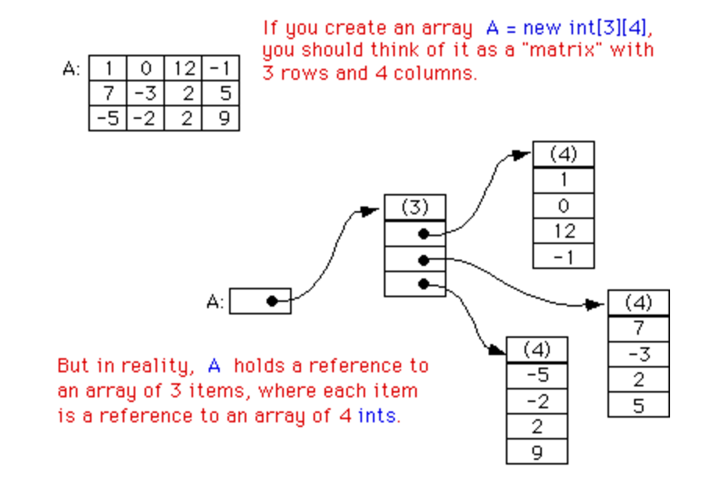
2D arrays: Abstraction and implementation
...
int[][] arr = { { 1, 0, 12, -1 },
{ 7, -3, 2, 5 },
{-5, -2, 2, 9 }, };
...
Abstract view
Physical view
arr:
arr:
A 2D array is implemented as a 1D array of references, each pointing to a 1D array.

Slide 17
Plan
2D arrays: Basic concepts
Example: Matrix operations
Internal view of 2D arrays
Aside topic: Reading data from a file
PageRank algorithm (example of 2D array processing)

Slide 18
Reading / processing a file
Example: Counts how many times integer values appear in a file.
OS function: displays the file
% more demo.dat
4
1 1 2
0 1 3 0 3
0 1
% java ReadFileDemo
0: 3
1: 4
2: 1
3: 2
/** Reads all the values in a file, skipping white space, and prints their * frequency. Precondition: The first value in the file, say N, indicates * that each value in the file is a non-negative int < N. */
public class ReadFileDemo {
public static void main(String[] args) {
// Creates an In object for representing the input (file)
In in = new In("demo.dat");
// Reads the upper-limit of the values
int N = in.readInt();
// Creates a frequency array
int[] count = new int[N];
// Reads and counts the values
while (!in.isEmpty()); {
int x = in.readInt();
count[x]++;
}
// Prints the frequency array
for (int i = 0; i < N; i++)
System.out.println(i + ": " + count[i]);
}
}
/** Library for reading files in Java */
public class In {
/** Initializes an input stream from the file. */
In(String fileName)
/** Reads the next token from the input,
* parses it as an integer, and returns the integer. */
public int readInt()
/** Returns true if the input is empty. */
public boolean isEmpty()
// More In functions follow.
}
The main point of this exercise is learning to read text files.
In class API

Slide 19
Plan
2D arrays: Basic concepts
Example: Matrix operations
Internal view of 2D arrays
Aside topic: Reading data from a file
PageRank algorithm (example of 2D array processing)

Slide 20

PageRank
PageRank Algorithm
How to Rank Web Pages According to their “Importance”

Slide 21
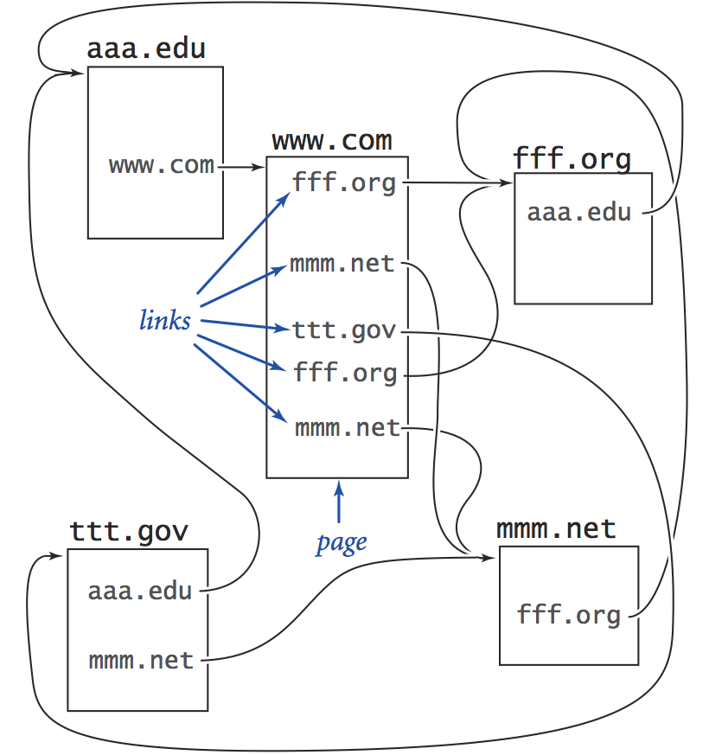
PageRank
Model of the web (consisting of 5 pages with hyperlinks):
abs
abs
The challenge: Rank web pages according to their importance

Slide 22
PageRank
Model of the web (consisting of 5 pages with hyperlinks):
abs
abs
The challenge: Rank web pages according to their importance
Importance: (i) the more visits a page gets, the more important it becomes
(ii) pages that get visits from important pages become more important
PageRank: The algorithm that Google uses to measure importance.

Slide 23
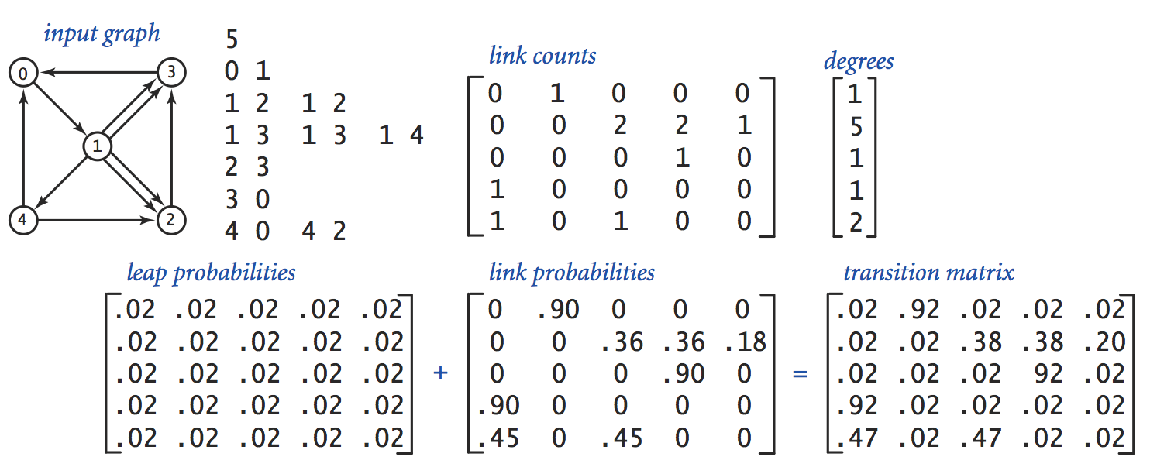
Model
Model of the web (consisting of 5 pages with hyperlinks):
graph model
data file
0
number of pages (N)
3
links
1
2
4
The challenge: Rank web pages according to their importance
Importance: (i) the more visits a page gets, the more important it becomes
(ii) pages that get visits from important pages become more important
PageRank: The algorithm that Google uses to measure importance.

Slide 24
Data structures
data file
nLink
nLinks
public class PageRank {
public static void main(String[] args) {
// Creates an In object for representing the input (file)
In in = new In("web.dat");
int N = in.readInt(); // number of pages
int[][] nLink = new int[N][N]; // nLink[i][j]: number of links from page i to page j
int[] nLinks = new int[N]; // nLinks[i]: total number of outgoing links from page i
// Reads the links data and computes the link counts
while (!in.isEmpty()) {
int row = in.readInt();
int col = in.readInt();
nLink[row][col]++;
nLinks[row]++;
}
...
/** A library for reading files in Java */
public class In {
/** Initializes an input stream from the file. */
In(String fileName)
/** Reads the next token from the input,
* parses it as an integer, and returns the integer. */
public int readInt()
/** Returns true if the input is empty. */
public boolean isEmpty()
// More In functions follow.
}
In class API

Slide 25
Data structures
data file
nLink
nLinks
+
=
p1[i][j] = probability of “leaping” from page i to page j
p2[i][j] = probability of going from page i to page j by clicking a link
p[i][j] = probability of going from page i to page j
Web surfing behavior (working assumption of PageRank):
When a user visits a page:
10% of the time the user “leaps” to some random page with equal probability
90% of the time the user clicks a random hyperlink within the current page

Slide 26
Data structures
data file
nLink
nLinks
+
=
. . .
// Reads the data file and constructs the nLinks and nLink matrices (previous slide)
. . .
// Constructs the transition matrix
double[][] transition = new double[N][N];
for (int i = 0; i < N; i++) {
for (int j = 0; j < N; j++) {
transition[i][j] = .10 / N +
.90 * ((double) nLink[i][j] / nLinks[i]);
}
}

Slide 27
Algorithm
transition matrix
.02 .92 .02 .02 .02
.02 .02 .38 .38 .20
.02 .02 .02 .92 .02
.92 .02 .02 .02 .02
.47 .02 .47 .02 .02
p[i][j] = probability that a random user goes from page i to page j
PageRank Algorithm
// Simulates a random user that makes T moves from one page to another.
// Counts how many times each of the N pages will be visited.
int[] count = int [N] // stores how many times each page was visited so far

Slide 28
Algorithm
transition matrix
.02 .92 .02 .02 .02
.02 .02 .38 .38 .20
.02 .02 .02 .92 .02
.92 .02 .02 .02 .02
.47 .02 .47 .02 .02
p[i][j] = probability that a random user goes from page i to page j
PageRank Algorithm
// Simulates a random user that makes T moves from one page to another.
// Counts how many times each of the N pages will be visited.
int[] count = int [N] // stores how many times each page was visited so far
page = 0 // starts the random walk at page 0
repeat T times:
// Selects the next page, using the row probabilities (Monte Carlo)
page = select a random integer from 0, ... , N – 1 with probability p[page , 0], ..., p[page , N – 1]
count [page]++
// Normalizes the page counts
for i = 0, ..., N – 1:
pageRank[i] = count [i] / T
In order to perform this simulation, we first have to compute the Cumulative Distribution Functions

Slide 29
Algorithm
transition matrix (PDFs)
CDFs matrix
.02 .92 .02 .02 .02
.02 .02 .38 .38 .20
.02 .02 .02 .92 .02
.92 .02 .02 .02 .02
.47 .02 .47 .02 .02
page 0:
page 1:
page 2:
page 3:
page 4:
.02 .94 .96 .98 1.00
.02 .04 .42 .80 1.00
.02 .04 .06 .98 1.00
.92 .94 .96 .98 1.00
.47 .49 .96 .98 1.00
PageRank Algorithm
// Simulates a random user that makes T moves from one page to another.
// Counts how many times each of the N pages will be visited.
int[] count = int [N] // stores how many times each page was visited so far
page = 0 // starts the random walk at page 0
repeat T times:
// Selects the next page, using the row probabilities (Monte Carlo)
page = select a random integer from 0, ... , N – 1 with probability p[page , 0], ..., p[page , N – 1]
count [page]++
// Normalizes the page counts
for i = 0, ..., N – 1:
pageRank[i] = count [i] / T
In order to perform this simulation, we first have to compute the Cumulative Distribution Functions

Slide 30
Algorithm
transition matrix (PDFs)
CDFs matrix
.02 .92 .02 .02 .02
.02 .02 .38 .38 .20
.02 .02 .02 .92 .02
.92 .02 .02 .02 .02
.47 .02 .47 .02 .02
page 0:
page 1:
page 2:
page 3:
page 4:
.02 .94 .96 .98 1.00
.02 .04 .42 .80 1.00
.02 .04 .06 .98 1.00
.92 .94 .96 .98 1.00
.47 .49 .96 .98 1.00
. . .
// Computes the CDF's of the PDF's represented by the transition matrix
double[][] CDF = new double[N][N];
for (int i = 0; i < N; i++) {
CDF[i] = MyRandom.CDF(transition[i]);
}
. . .
/** Library of statistical and random functions.*/
public class MyRandom {
/** Creates a CDF from a given PDF. */
public static double[] CDF(double[] p)
/** Generates a random integer from a given CDF. */
public static int rnd(double[] P)
...
}
How to construct a CDF from a PDF, and how to generate random events using a CDF, was described in lecture 4-1.
MyRandom API

Slide 31
Implementation
CDFs matrix
page 0:
page 1:
page 2:
page 3:
page 4:
.02 .94 .96 .98 1.00
.02 .04 .42 .80 1.00
.02 .04 .06 .98 1.00
.92 .94 .96 .98 1.00
.47 .49 .96 .98 1.00
...
// Reads the data file and constructs the transition and CDF matrices (previous slides)
...
/** Library of statistical and random functions.*/
public class MyRandom {
/** Creates a CDF from a given PDF. */
public static double[] CDF(double[] p)
/** Generates a random integer from a given CDF. */
public static int rnd(double[] P)
...
}
MyRandom API

Slide 32
Implementation
CDFs matrix
page 0:
page 1:
page 2:
page 3:
page 4:
.02 .94 .96 .98 1.00
.02 .04 .42 .80 1.00
.02 .04 .06 .98 1.00
.92 .94 .96 .98 1.00
.47 .49 .96 .98 1.00
...
// Reads the data file and constructs the transition and CDF matrices (previous slides)
...
// Simulates the behavior of a user who makes T random moves (command-line argument).
// In each move, a random page is selected using the transition probability from the current page.
int[] count = new int[N]; // how many times each page was visited
int T = Integer.parseInt(args[0]); // number of moves
int page = 0; // Starts at page 0
// Makes T moves
for (int t = 0; t < T; t++) {
// Selects randomly which page to go to
page = MyRandom.rnd(CDF[page]);
count[page]++;
}
// End of simulation: Prints the pageranks the pages
for (int i = 0; i < N; i++)
System.out.print((double) count[i] / T);
/** Library of statistical and random functions.*/
public class MyRandom {
/** Creates a CDF from a given PDF. */
public static double[] CDF(double[] p)
/** Generates a random integer from a given CDF. */
public static int rnd(double[] P)
...
}
MyRandom API

Slide 33
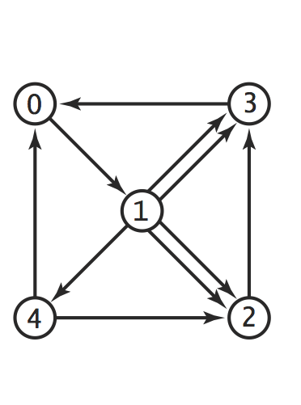
Results
% more web.dat
5
0 1
1 2 1 2
1 3 1 3 1 4
2 3
3 0
4 0 4 2
% java PageRank 10000000
Page ranks:
0.273 0.266 0.146 0.247 0.068

Slide 34
Results
0.27
0.24
% more web.dat
5
0 1
1 2 1 2
1 3 1 3 1 4
2 3
3 0
4 0 4 2
% java PageRank 10000000
Page ranks:
0.273 0.266 0.146 0.247 0.068
0.26
0.06
0.14

Slide 35
PageRank class (all the pieces together, nothing new in this slide)
public class PageRank {
public static void main(String[] args) {
// Creates an In object for representing the input (file)
In in = new In("web.dat");
int N = in.readInt(); // number of pages
int[][] nLink = new int[N][N]; // nLink[i][j]: number of links from page i to page j
int[] nLinks = new int[N]; // nLinks[i]: total number of outgoing links from page i
// Reads the links data and computes the link counts
while (!in.isEmpty()) {
int row = in.readInt();
int col = in.readInt();
nLink[row][col]++;
nLinks[row]++; }
// Constructs the transition matrix
double[][] transition = new double[N][N];
for (int i = 0; i < N; i++)
for (int j = 0; j < N; j++)
transition[i][j] = .10 / N + .90 * ((double) nLink[i][j] / nLinks[i]);
// Computes the CDF's of the PDF's represented by the transition matrix
double[][] CDF = new double[N][N];
for (int i = 0; i < N; i++)
CDF[i] = MyRandom.CDF(transition[i]);
// Simulates the behavior of a user who makes T random moves.
// In each move, a random page is selected from the current page.
// The random selection is made using the CDF of the current page.
int[] count = new int[N]; // how many times each page was visited
int T = Integer.parseInt(args[0]); // number of moves
int page = 0; // Starts at page 0
// Makes T moves
for (int t = 0; t < T; t++) {
// Selects randomly which page to go to
page = MyRandom.rnd(CDF[page]);
count[page]++;
}
System.out.println("Page ranks:");
for (int i = 0; i < N; i++) { System.out.printf("%7.3f", (double) count[i] / T); }
}
}
% more web.dat
5
0 1
1 2 1 2
1 3 1 3 1 4
2 3
3 0
4 0 4 2
% java PageRank 10000000
Page ranks:
0.273 0.266 0.146 0.247 0.068

